Slide 1

Failure to Function A review of the care received by patients who died in hospital following an admission with acute heart failure
Principal recommendations
Notes:
Presenter’s notes:
This presentation can be used to present the principal recommendations from the report Failure to Function. This looked at care received by patients who died in hospital following an admission with acute heart failure. The study covered the whole of the UK including off-shore islands.
It will only cover the principal recommendations and the full set of recommendations can be found in the report.
More information can be found at www.ncepod.org.uk.

Slide 2
The study
Review of the process of care for patients with acute heart failure admitted to hospital as an emergency and died during the admission.
Organisational questionnaire
Clinician questionnaire
Case note review
Notes:
Presenter’s notes:
The study looked at the care of patients with acute heart failure who were admitted to hospital as an emergency and died during the admission. The quality of care was assessed by collecting information on an organisational level and on individual patients through questionnaires completed by clinicians and review of case notes.
Case notes are reviewed by clinicians working with people with acute heart failure.

Slide 3
Study population
All patients aged 16+ who were admitted as emergencies between 1st January and 31st December 2016 inclusive with a primary diagnosis of heart failure and died in hospital
A subpopulation of patients who died in hospital within seven days of admission were selected for detailed review of their care
Notes:
Presenter’s notes:
The study included patients aged 16 and older who were admitted as emergencies between 1st January and 31st December 2016 inclusive with a primary diagnosis of heart failure and who died in hospital. 11,455 were identified initially.
4,768 patients died in hospital within 7 days of admission.

Slide 4
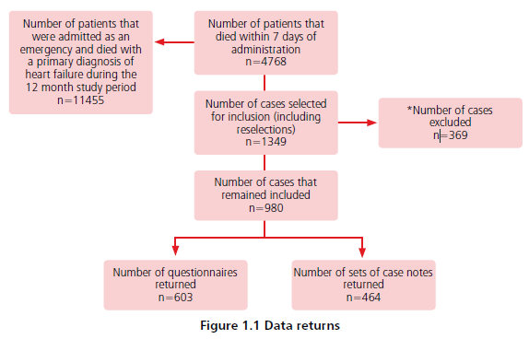
Study sample
Notes:
Presenter’s notes:
Of the 4,768 patients who died within 7 days of admission, 1349 were selected for inclusion in the study.
369 were then excluded – in most cases this was because, on review of the case notes, the patients were not deemed to have had an episode of acute heart failure.
The final sample was 980 cases. For these, 603 questionnaires were received and 464 sets of case notes.

Slide 5
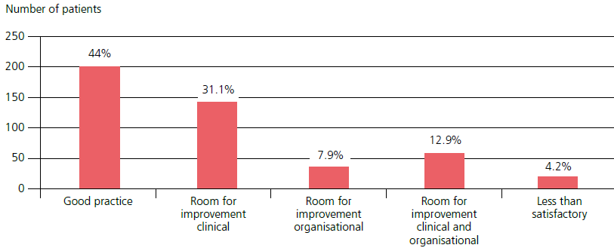
Overall assessment of care
Notes:
Presenter’s notes:
Overall, the case reviewers considered 44% of the sample to have demonstrated good practice. Almost a third showed room for improvement in clinical aspects and 12% showed room for improvement in both clinical and organisational aspects of care. Care was less than satisfactory in 4% of cases.

Slide 6
Key messages
Room for improvement in clinical care
Particularly for patients with newly diagnosed heart failure
Lack of access to a heart failure specialist
More patients should have been referred to or discussed with the palliative care team
Few patients with either established heart failure or a new diagnosis had serum natriuretic peptide measured
Echocardiography was not done for the majority of patients with established heart failure
Notes:
Presenter’s notes:
There was room for improvement in the clinical care of 44% of the patient cases reviewed. This applied in particular to patients with newly diagnosed heart failure.
Access to a heart failure specialist was achieved in just 33% of patients.
25% of patients were referred to or discussed with the palliative care team. It was felt that an additional 121 cases reviewed should have been discussed with palliative care.
15.7% of patients with established heart failure and 19.9% of patients with a new diagnosis received serum natriuretic peptide measurement, despite it being recommended in guidelines and being widely available in hospitals.
Echocardiography for accurate diagnosis and assessment of prognosis is an essential part of the assessment of patients with heart failure. This was done in 22.3% of patients with established heart failure and 44.2% of patients with a new diagnosis.

Slide 7
Principal Recommendation (1)
A guideline for the clinical management of acute heart failure should be available in all hospitals, including:
location of care - on a specialist unit
arrangements for heart failure service review within 24 hours
initial investigations required for diagnosis, including a standard protocol for the use of:
BNP/NTproBNP testing
Echocardiography
immediate treatments (medications guidance for treatment prior to specialist review)
Notes:
Presenter’s notes:
This recommendation is aimed at Medical Directors, Directors of Nursing, Clinical Directors.
The guideline should cover:
Location of care, which should be on a specialist unit
How to access a heart failure service review within 24 hours
Initial investigations for diagnosis
Immediate treatments.
This recommendation supports NICE guideline CG187
This recommendation refers to the specialist heart failure/cardiology team review - see also RECOMMENDATION 2 regarding all acute admissions and consultant review within 14 hours of admission.

Slide 8
Principal Recommendation (1)
Hospitals should audit against these standards annually.
Notes:
Presenter’s notes:
The standards in the guideline should be monitored to ensure that they are being met.

Slide 9
Principal Recommendation (3)
Heart failure patients should have access to a heart failure multidisciplinary team.
Core membership of this team should include:
clinician with a sub-speciality interest in heart failure
specialist heart failure nurse
healthcare professional with expertise in specialist prescribing for heart failure
primary care team
specialist in palliative care
Cardiac rehabilitation, physiotherapy, occupational therapy, clinical psychology, elderly care, dietetics and clerical support as needed.
Notes:
Presenter’s notes:
This recommendation is aimed at Commissioners, Medical Directors, Directors of Nursing and Clinical Directors.
This recommendation supports the draft NICE guidelines for chronic heart failure management outlining the core membership. NCEPOD have also included the addition of palliative care in the core group.
This should include:
A clinician with an interest in heart failure
A specialist nurse
A professional with expertise in specialist prescribing
The primary care team
A palliative care specialist
Other services should be involved as needed.

Slide 10
Principal Recommendation (5)
Serum natriuretic peptide measurement should be included in the first set of blood tests in all patients with acute breathlessness and who may have new acute heart failure.
Notes:
Presenter’s notes:
This recommendation is aimed at all clinicians.
Serum natriuretic peptide measurement is central to the assessment of these patients to guide further investigation. It should be included in the first set of blood tests for patients with acute breathlessness and who may have new acute heart failure. It is central to the assessment of these patients to guide further investigations.
This recommendation supports NICE guideline CG187 rec 1.2.2

Slide 11
Principal Recommendation (6)
An echocardiogram should be performed for all patients with suspected acute heart failure
as early as possible after presentation to hospital
within a maximum of 48 hours
Notes:
Presenter’s notes:
This recommendation is aimed at all Clinicians, Lead Physiologists and Medical Directors
An ECG should be performed within 48 hours. It is the key to diagnosis, risk stratification and specialist management of acute heart failure.
This recommendation supports NICE guideline CG187 rec 1.2.4

Slide 12
Principal Recommendation (8)
For all patients with heart failure, best practice in escalation decision making includes:
Assessment of the goals and benefits of treatment escalation
Inclusion of the patient (and their family where possible)
Involvement of the cardiology or heart failure consultant
Agreement among members of the multidisciplinary team
Communication of the decision with healthcare professionals across the whole care pathway
Notes:
Presenter’s notes:
This recommendation is relevant to Heart Failure Teams and Consultant Cardiologists.
Best practice for making decisions about escalating a patient to a higher level of care should cover:
The goals and benefits of treatment escalation
Involvement of the patient, family and cardiology or heart failure consultant
MDT agreement
Communication with healthcare professionals across the care pathway

Slide 13
Principal Recommendation (8)
For patients with advanced heart failure, pre-emptive discussion in the outpatient setting of treatments that would not be beneficial, along with consideration of palliative care needs, can prevent unnecessary admissions and should be encouraged.
Escalation decisions should be reviewed at the time of all admissions with acute heart failure.
Notes:
Presenter’s notes:
For patients with advanced heart failure, pre-emptive discussion in the outpatient setting of treatments that would not be beneficial and consideration of palliative care needs, can prevent unnecessary admissions and should be encouraged.
Escalation decisions should be reviewed at the time of all admissions with acute heart failure.
Treatment and care towards the end of life: good practice in decision making (GMC 2010)

Slide 14
Discussion
Do we have a local guideline?
Do we have a heart failure MDT?
Is serum natriuretic peptide measurement included in first blood tests?
Are ECGs done for all patients with suspected acute heart failure?
When are they done?
Are patients being referred to, or discussed with, the palliative care team?
Notes:
Presenter’s notes:
These are some questions that could be used to generate local discussion and start action planning, but you may want to use your own questions. It may be helpful to use other NCEPOD resources, such as the recommendation checklist, to decide what (if any) changes need to be made.

Slide 15
Failure to Function
Full report, summary and implementation tools can be found at
www.ncepod.org.uk/2018ahf.html

